Slide 1
Dataset
Dataset : https://www.kaggle.com/c/titanic/data

Slide 2
CLASSIFICATION
Classification is the problem of identifying to which set of categories (sub-populations) a new observation belongs, based on a training set of data containing observations (or instances) whose category membership is known.

Slide 3
Binary Classification
It is a type of classification which involves only two categories. i.e all the observations can be split into two categories.
Examples
Checking if email is spam or not
Whether a tumour is malignant or not

Slide 4
Multiclass classification
Here the observations can be split into more than two categories.
Examples
Match prediction (Win/loss/draw)
Predicting the cover type in a forest

Slide 5
How to solve such classification problems ?
Can we use Linear regression ?
We can threshold the classifier output (i.e. anything over some value is yes, else no)
For example, if we have a binary classification we can set threshold as 0.5 and depending upon the classifier output we can predict

Slide 6
Issues
Few outliers can spoil the model.
The value of the classifier output may be more than 1 or less than 0. But it should be between 0 and 1.
It leads to erroneous outputs.

Slide 7
Logistic Regression
So we need an algorithm which gives value between 0 or 1(or It can generate only discrete values 0 and 1).
Logistic regression is a classification algorithm.
It is used to solve binary as well as multi class classification problems.

Slide 8
Hypothesis Representation
When using linear regression we used h_{θ}(x) = (θ^{T} x)
For classification hypothesis representation we do h_{θ}(x) = g((θ^{T} x))
Where we define g(z)
z is a real number
g(z) = 1/(1 + e^{-z})
This is the sigmoid function, or the logistic function

Slide 9
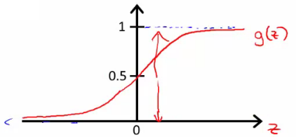
Why did we use a different hypothesis ?
The graph of the above hypothesis looks as below

Slide 10
Contd..
It crosses 0.5 at the origin and flattens out (i.e it has asymptodes when the y value is at 1 or 0)
So basically it gives 0 at negative infinity and 1 at positive infinity
So we can be assured that the value returned by the function is between 0 and 1.
Then we can use some threshold for Predicting the value.

Slide 11
Understanding what hypothesis is computing
The sigmoid function g(z) gives a value greater than 0.5 when the value of z is positive.
θ^{T} x >= 0
So if we set the threshold as 0.5 then we can say that
If value of z is positive then it predicts 1
Or else it will give you 0.

Slide 12
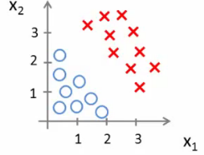
Decision Boundary with Example
Consider the following diagram

Slide 13
Contd
Assume that
h_{θ}(x) = g(θ₀ + θ₁x₁ + θ₂x₂)
So if we have set the threshold as 0.5 then we can say
The model outputs the value 1 if
θ₀ + θ₁x₁ + θ₂x₂ > 0
2. It will output 0 in the other case.

Slide 14
Decision Boundary
The decision boundary is a property of the hypothesis
Means we can create the boundary with the hypothesis and parameters without any data
Later, we use the data to determine the parameter values
We use decision boundary to split the observations into different categories

Slide 15
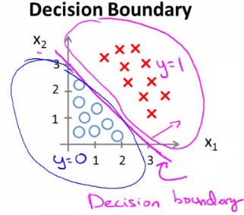
Linear Decision boundary
For the above example using the same h(x) we will get decision boundary which looks something like this

Slide 16
Non linear Decision boundary
Suppose our classifier has higher order terms
Used logistic regression to fit a complex non-linear data set
Because just a linear fit won’t be able to fit all models
It may require some function like this
h_{θ}(x) = g(θ₀ + θ₁x₁+ θ₃x₁² + θ₄x₂²)

Slide 17
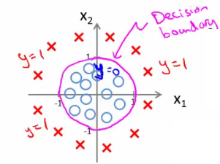
Contd..
In such cases the decision boundary won’t be linear.
One such example is given here:

Slide 18

Cost Function
For linear regression we use the following the cost function
This is the cost you want the learning algorithm to pay if the outcome is h_{θ}(x) and the actual outcome is y

Slide 19
If we use this function for logistic regression this is a non-convex function for parameter optimization
Our hypothesis function has a non-linearity (sigmoid function of h_{θ}(x) ). This is a complicated non-linear function
If you take h_{θ}(x) and plug it into the Cost() function, and them plug the Cost() function into J(θ) and plot J(θ) we find many local optimum because it’s a non convex function
Lots of local minima mean gradient descent may not find the global optimum - may get stuck in a global minimum
We would like a convex function so if you run gradient descent you converge to a global minimum

Slide 20

So what do we do ?
We need a different convex cost function
So our new cost function which is given below

Slide 21
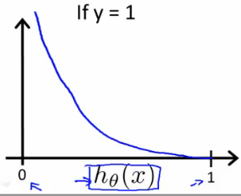
How exactly the cost function is penalizing ?
If y = 1, the cost function looks as below
As you can see the function is tending to infinity(penalising heavily) as h(x) Is tending to 0 and the penality is tending to zero when h(x) is tending to 1.

Slide 22
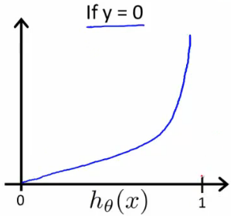
For y= 0 the cost function looks like this
As you can see the function is tending to infinity(penalising heavily) as h(x) Is tending to 1 and the penality is tending to zero when h(x) is tending to 0.

Slide 23
Email : gurupradeept@gmail.com
You can find the here :
https://github.com/Gurupradeep/Machine-Learning/blob/master/Titanic2.R

